Slide 1
Qualitative Data Analysis

Slide 2
The principles of qualitative data analysis
Preparing qualitative data for analysis
First, the original data should be protected.
Back-up copies should be made of all original materials and it is generally advisable to use these back-up copies during the process of data analysis so that the originals can be preserved and protected against any unintentional corruption or damage.
Second, the data should be catalogued and indexed. Each piece of ‘raw data’ should be identified with a unique serial number for reference purposes.

Slide 3
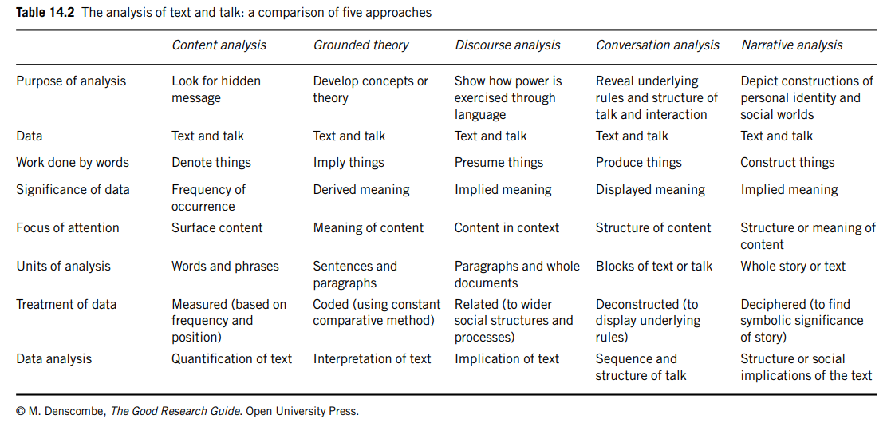

Slide 4
Content analysis
Content analysis can be used with any ‘text’, whether it is in the form of writing, sounds or pictures.
It is used as a way of quantifying the contents of that text., by identifying patterns, themes, meanings, or frequencies of words, phrases, or concepts.
Political scientists might use it to study the transcripts of speeches, educationists to study the content of children’s books, and historians to study statesmen’s correspondence.
Whatever its specific application, content analysis generally follows a logical and relatively straightforward procedure.

Slide 5
Steps – Content Analysis
1. Choose an appropriate sample of texts or images.
2. Break the text down into smaller component units.
3. Develop relevant categories for analyzing the data.
4. Code the units in line with the categories.
5. Count the frequency with which these units occur.
6. Analyse the text in terms of the frequency of the units and their relationship with other units that occur in the text.
Public perception of Artificial Intelligence in Sri Lanka”,
you could:
Collect articles, tweets, and blog posts.
Code them as positive, negative, or neutral.
Count and interpret results to see how attitudes have changed over time.

Slide 6
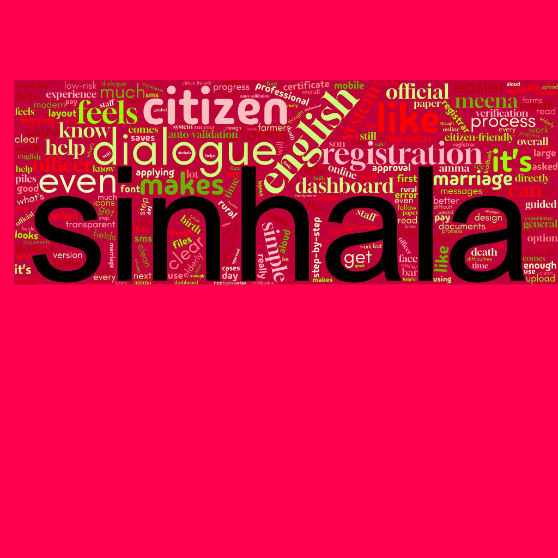

Slide 7
Grounded theory
The grounded theory approach is primarily associated with the analysis of interview transcripts (although it can be used with a variety of types of qualitative data).
The analysis requires a detailed scrutiny of the text and involves a gradual process of coding and categorizing the data.
The ultimate goal of the analysis is to derive concepts and theories that capture the meaning contained within the data.
The grounded theory approach is ‘inductive’ in the sense that it seeks to use findings from particular instances as the basis for developing statements that apply at a general level.

Slide 8
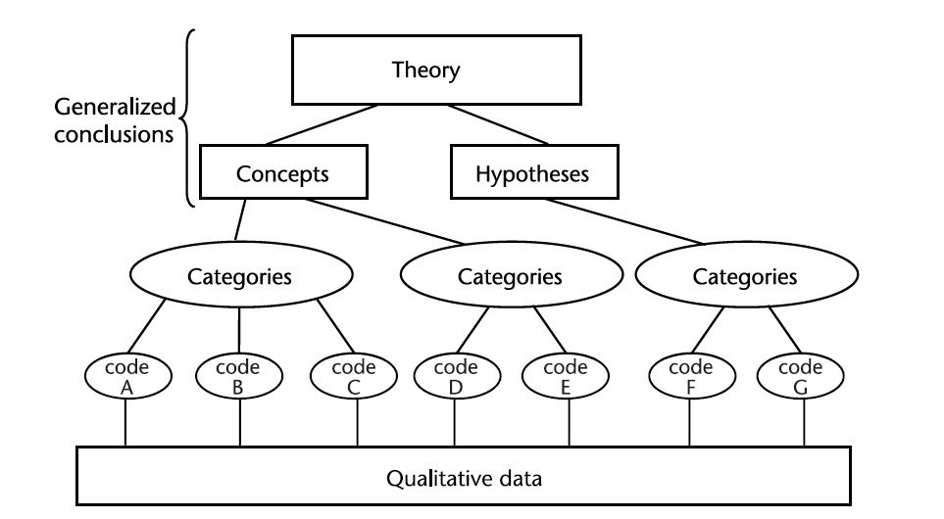

Slide 9
Discourse analysis
Discourse analysis is an approach to the analysis of qualitative data that focuses on the implied meaning of the text or image rather than its explicit content.
It is based on the premise that words and pictures are used not simply to depict reality; they are used instead as a way of creating and sustaining reality.

Slide 10
More on Discourse Analysis
Discourse analysis involves a ‘deconstruction’ of the data in order to expose the ways in which text or visual images do the work of creating or sustaining particular aspects of social life.
This approach is familiar within the fields of social psychology, sociology and linguistics and is used in relation to a wide range of social research areas including, for example, cultural studies, marketing (especially advertising), education and feminist studies.

Slide 11
Conversation analysis
Conversation analysis is often considered to be a variant of discourse analysis because it focuses attention on how things get done through language use.
In this instance, researchers look at naturally occurring talk and the way that routine aspects of everyday life get accomplished through language.

Slide 12
Narrative analysis
A narrative relates to a story. A story can be told in many forms; in writing through books and in speech through interviews, as well as a whole host of other mediums perhaps less commonly used as sources of data by social researchers such as visual images, music and drama.
Treated as a narrative, though, the story needs to have certain properties (Reissman 2003, 2008; Elliott 2005: Andrews et al. 2008).

Slide 13
Thematic Analysis
Thematic analysis is a qualitative analysis method used in the social sciences to identify and present recurring patterns or themes in data.
It involves careful reading and interpretation of the material to extract meaning and understand different subjects and interpretations.

Slide 14
6-Phase Approach to Thematic Analysis
  Familiarizing yourself with the data
  Generate initial codes
  Search for themes
  Review potential themes
  Define and naming themes
  Produce the report
Braun, V. & Clarke, V. (2012). Thematic analysis. In H. Cooper, P. M. Camic, D. L. Long, A. T. Panter, D. Rindskopf, & K. J. Sher (Eds), APA handbook of research methods in psychology, Vol. 2: Research designs: Quantitative, qualitative, neuropsychological, and biological (pp. 57-71). Washington, DC: American Psychological Association.

Slide 15
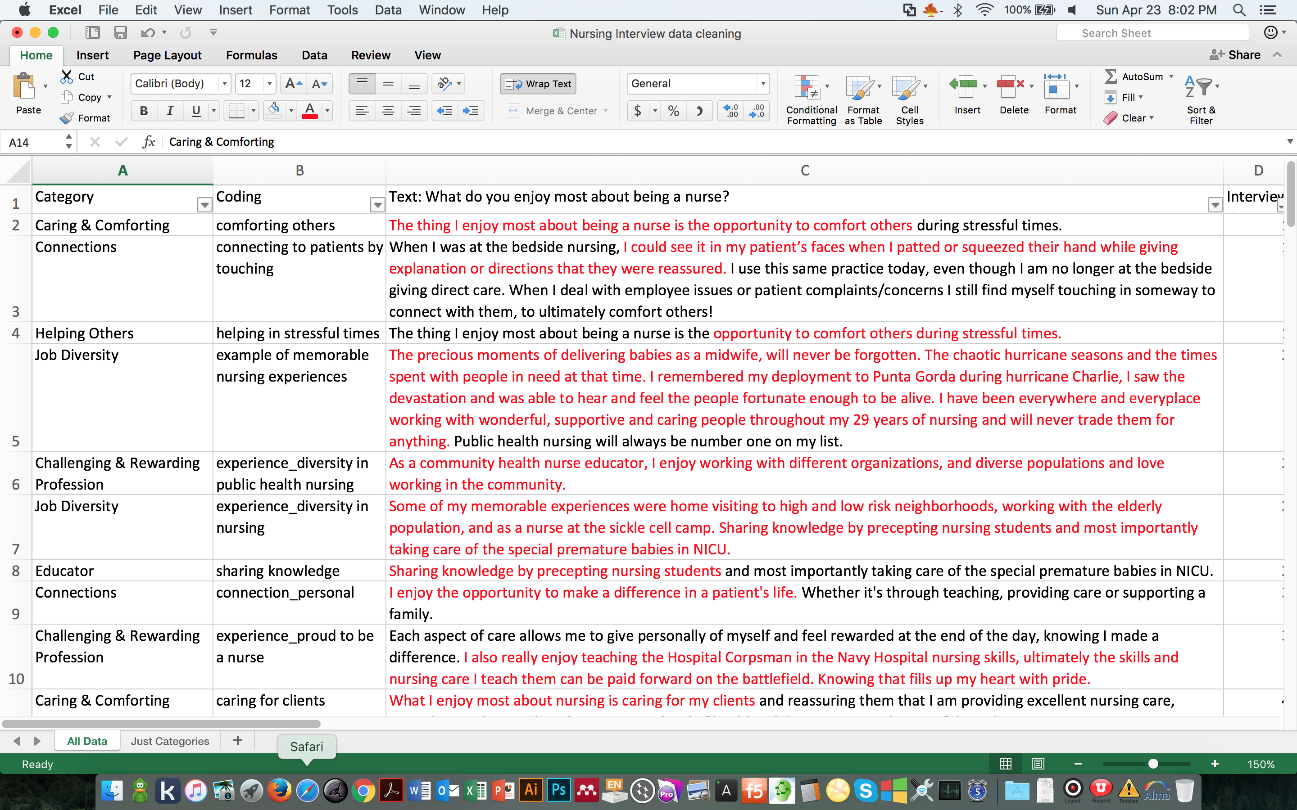
Excel Coding Examples
Can filter and sort in Excel, can search for text and words – makes it easier

